Slide 1
American Rescue Plan Act
Treasury Reporting Portal
April 7, 2026

Slide 2
PSATS Contacts
Katie Lizza
  Deputy Director of Policy & Research
  Klizza@psats.org
  717-763-0930 ext. 126
Holly Fishel
  Policy & Research Director
  Hfishel@psats.org
  717-763-0930 ext. 138
1

Slide 3
Agenda
Brief recap of ARPA/SLFRF
Accessing Treasury's Portal
Filing the Project and Expenditure Report
  If you'd like to follow along and complete your report, log into portal.treasury.gov/compliance
  Recommendations and Troubleshooting
Compliance Overview
Filing the Closeout Report
Questions
2

Slide 4
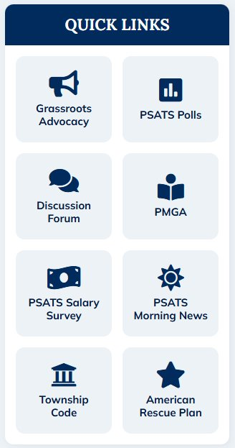
PSATS ARP Guidance Available
Resources, tips, and fact sheets are available on our ARP page
Head to psats.org and choose American Rescue Plan in the Quick Links
  Direct link to Treasury's Portal
  SAM.gov renewal guide
  Presentation slides and a link to this webinar
3

Slide 5
spending & reporting recap
American Rescue Plan Funds (aka SLFRF)
4

Slide 6
ARP Funds Recap
Townships received federal funds from the American Rescue Plan Act to assist with pandemic-related and other allowable expenses in 2021 and 2022
ARP funds needed to be at least obligated (if not already spent) by December 31, 2024
  If obligated under a contract or purchase order, municipalities have until December 31, 2026 to spend
5
Notes:
Any funds not used must be returned to Treasury as part of the award closeout process pursuant to 2 C.F.R. 200.344(d).

Slide 7
Revenue Replacement Recap
Townships should report all ARP funds as “Revenue Replacement” for “Government Services”
  Expenditure Category 6.1
  Includes roads and bridges, water and sewer infrastructure, parks and recreation, public buildings, vehicles, equipment, police and fire protection, ambulance service, payroll, administration expenses
  Even if spent under one of the other allowable categories, report under Revenue Replacement
If you received less than $10 million, you should be reporting all expenditures in one or more existing Revenue Replacement “projects”
6

Slide 8

Tip: Why Use Revenue Replacement?
Using any other project expenditure category – even categories that appear "correct" - will result in a more difficult report, with more burdens placed on administrators:
  must document all expenses
  must document that expenses met the rules for that particular category
  additional scrutiny to determine if the funds were used appropriately
Revenue Replacement makes your report
easier, more streamlined, and simplifies
compliance requirements
7

Slide 9
Accessing treasury's portal
Reporting Requirements
8

Slide 10
Reporting and Compliance
Each township that received ARP funds and did not file an early closeout report must file a Project and Expenditure Report this year
  Required even if your township spent AND reported all funds as spent in a previous year!
After submitting a P&E report, with all funds reported as obligated and spent, keep an eye on your email for an invitation to submit a closeout report
Current P&E report is due by April 30, 2026
9

Slide 11
Accessing Treasury's Portal
Portal users need a login.gov account to access (can also use id.me)
Access Treasury's reporting portal at: https://portal.treasury.gov/compliance
  Visit our ARP page at psats.org for a direct link
Treasury recommends using Google Chrome or Microsoft Edge for this site
10
Notes:
Could use id.me but most townships are using login.gov

Slide 12
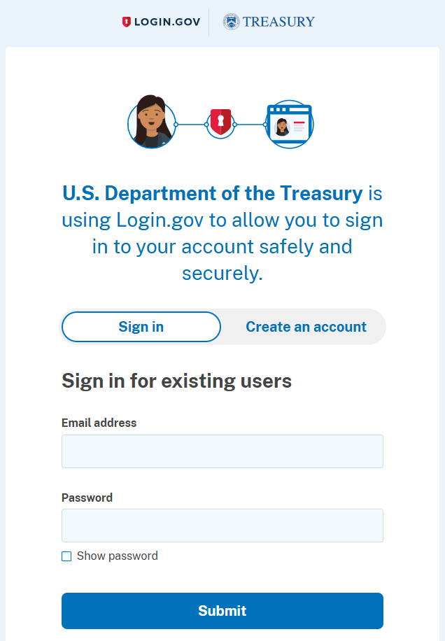
Treasury's Portal – login.gov sign on
Enter your login.gov email and password to continue to Treasury's Reporting and Compliance Portal
  Same email and password to access SAM.gov and FHWA
Requires authentication method for security (text message, phone call, backup codes)
11

Slide 13
Login.gov Authentication Issues
In addition to a password, login.gov requires at least one authentication method
Can't access the authentication code? (ex: the code is going to someone else's phone)
  Delete your login.gov account
    On the authentication page, click “Choose another security option”
    Scroll to the bottom and click “deleting your account”
    Keep an eye on your email! You will receive an email in 24 hours to confirm deletion. After deleting, you can recreate the account with same email address
    When creating a new login.gov, we recommend avoiding the backup codes as your primary option
12

Slide 14
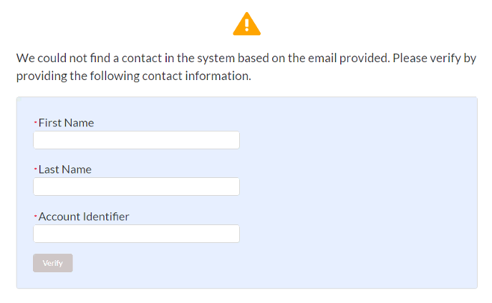
I logged in but can't access the portal
Someone at the township was designated as the "Account Administrator"
  Option 1: If the administrator is with the township, they can add you from within the portal
  Option 2: The "unique account ID" was emailed to the administrator in March 2023 (bolded, red code with 32 letters and numbers)
  Option 3: If the administrator is no longer with the township and you don't have access to that email, notify Treasury...
13

Slide 15
Email Treasury with Login Issues
If the Account Administrator is no longer with the township/cannot add you, email Treasury ASAP!
  SLFRF@Treasury.gov and COVIDReliefITSupport@Treasury.gov
  Provide your name, login.gov email address, township name, county, state, and NEU#
  Explain your issue clearly (ex: The prior administrator is no longer with my municipality. I am the new administrator and need all roles to submit the 2026 P&E Report.)
  Send screenshots when able!
14
Notes:
FYI: 844-529-9527 is the SLFRF Contact Center == Please keep in mind, this number is NOT a helpdesk and will not be able to troubleshoot with you. They can only put in a ticket on your behalf.

Slide 16
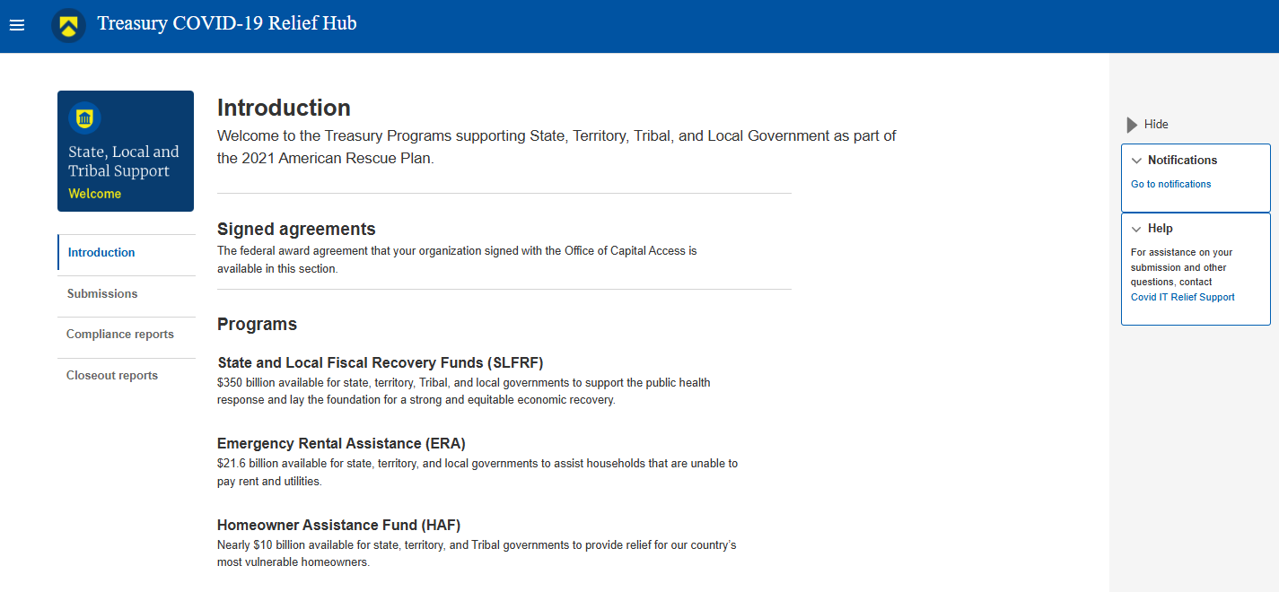
Portal Home Page
“Hamburger” button is your navigation option to return to the home page
15

Slide 17
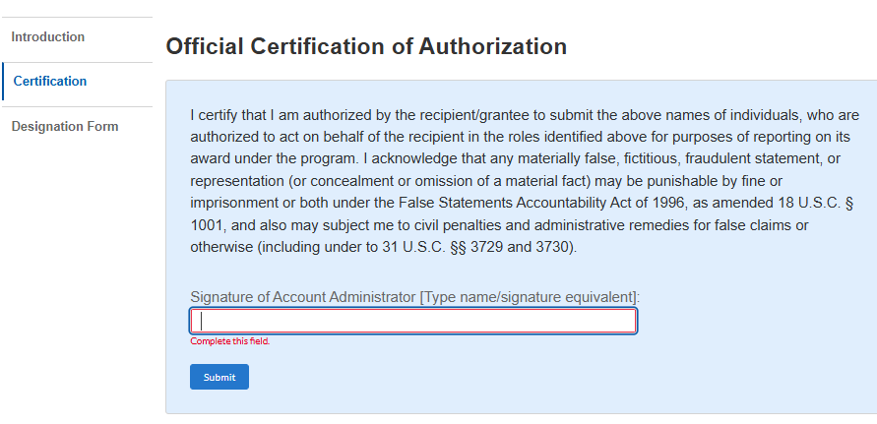
Adding and Changing Roles
This may be your last chance to make sure your points of contact are accurate!
  Click "hamburger" button and choose Account
  Choose your township name to get to Account Roles page
  On Certification screen, enter your name and click submit. This should reveal the Designation Form tab
16

Slide 18
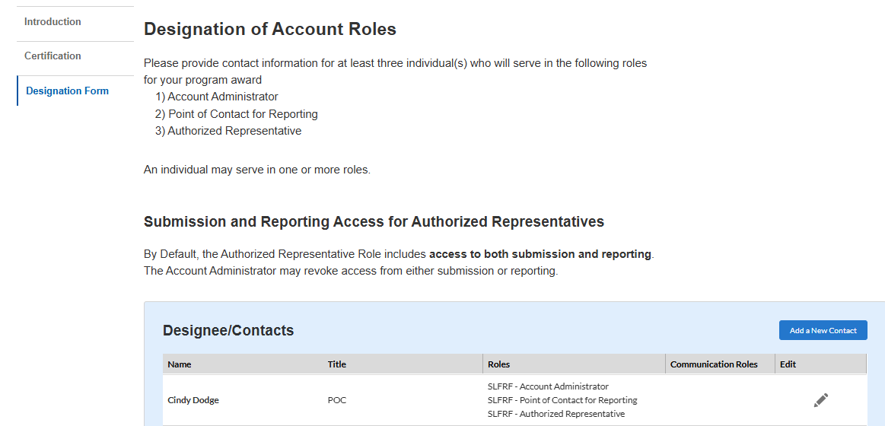
Adding/Editing Contacts and Roles
The Designation Form will display all contacts in your account.
Click the pencil next to a name to edit roles
Click Add a New Contact to add someone new
The system will not allow you to enter two individuals under the same email address!
The system will not allow you to delete anyone! Simply remove all roles if they are no longer with the township.
17

Slide 19
Project and expenditure report walkthrough
Reporting Requirements
18

Slide 20
Going to the Report
Click on Compliance Reports to get started
19

Slide 21
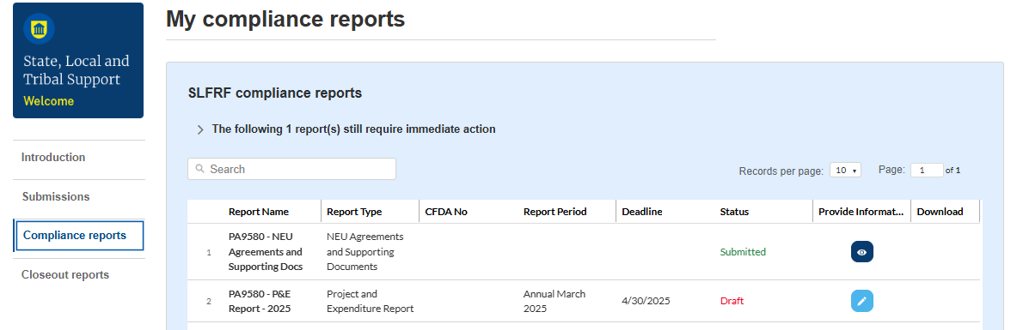
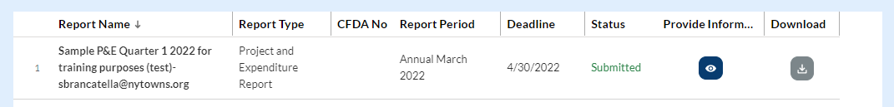
Going to the Report
Click the blue pencil to select the 2026 Project and Expenditures Report
2026
2026
4/30/2026
Prior year reports will display as well:
20

Slide 22
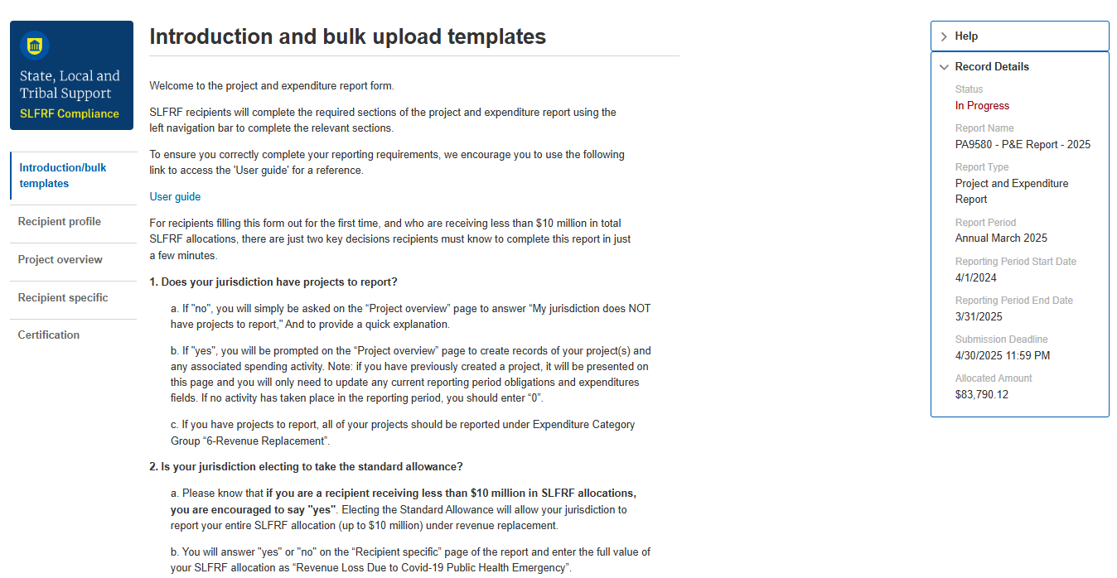
Allocated Amount on Introduction Page
Tip: Write down the "Allocated Amount" - this is your township's full award and will be needed on future pages.
Click next to continue.
2026
2026
4/1/2026
Tip: Work your way down this sidebar or click Next at the bottom of the pages to proceed
3/31/2026
4/30/2026
$25,000.00
2026
21

Slide 23
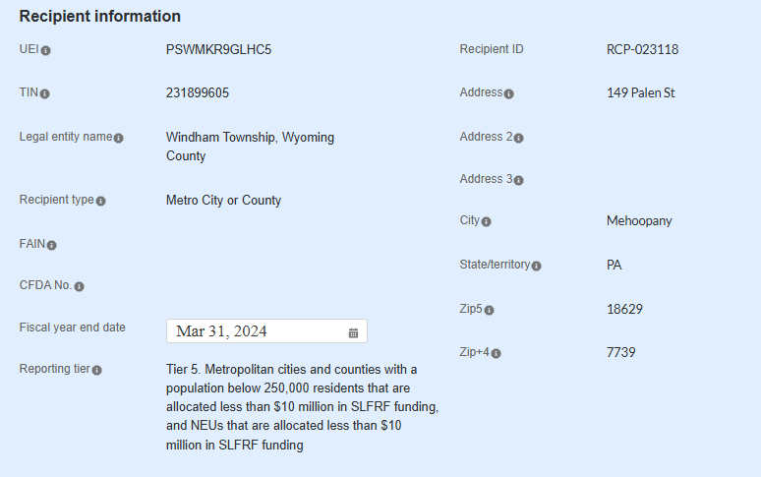
Recipient Profile Page
All of the information about your township should be pre-filled. Enter Fiscal Year End Date and then continue
If this field is not working, continue on and come back to this page later (you may need to try submitting the report and receive an error to have this page refresh)
ABCDEFG12345
987654
123456789
123 Main St.
Great Township, Liberty County
Great
12345
December 31, 2025
0000
22

Slide 24
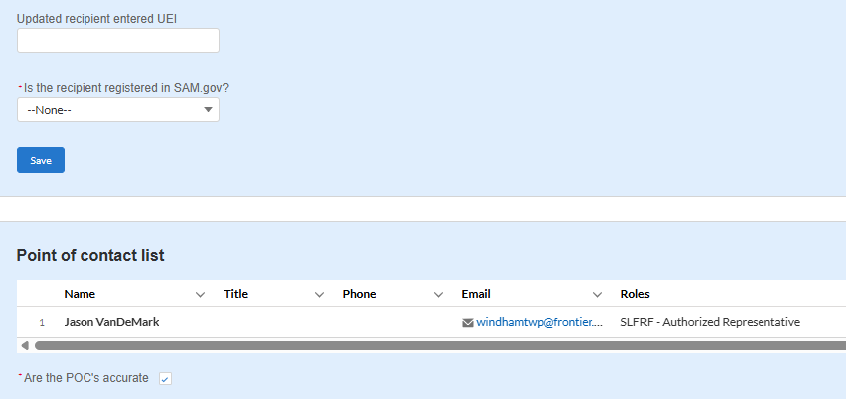
Recipient Profile Page
Confirm registration in SAM.gov
Verify Points of Contact are accurate (remember, you cannot make changes to contacts on this page)
23

Slide 25
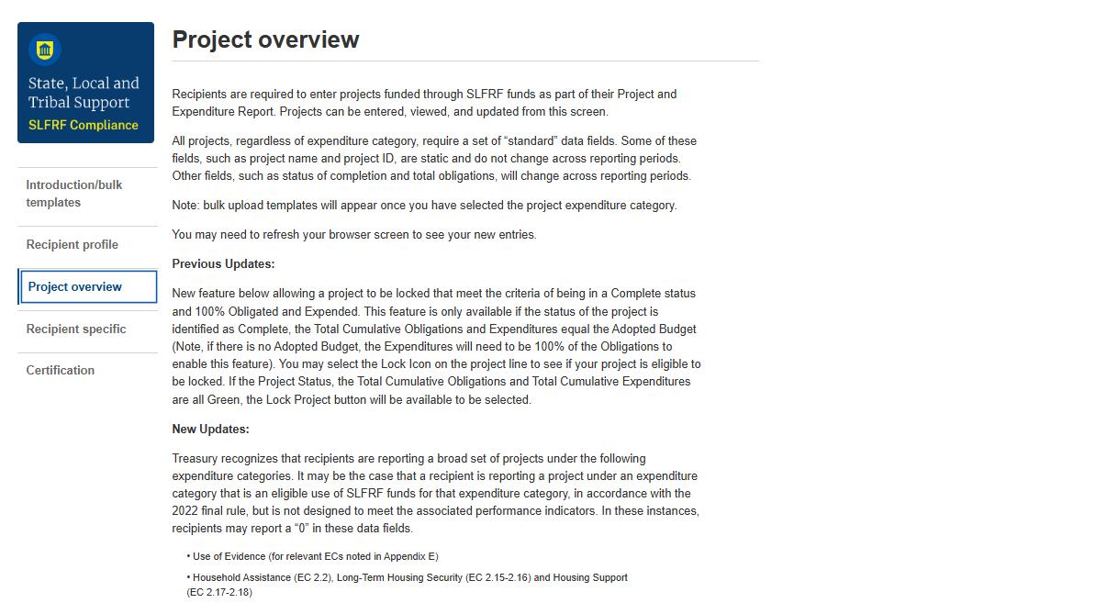
Project Overview Page
Scroll down to find previously entered projects
24

Slide 26
Tip: What to have on hand for projects
Full allocated award amount
Information on ARP activity including dollar amounts, descriptions, and timeframes
  “Cumulative” – total obligations and expenses since you received the ARP funds
  “Current Period” – obligations and expenses ONLY between April 1, 2025 - March 31, 2026
25

Slide 27
Two Scenarios in Project Overview
Scenario 1: Your township already spent and reported all funds as project under Revenue Replacement in a prior reporting year
Scenario 2: Your township has a project entered, but had not spent all award funds until this reporting period
26

Slide 28
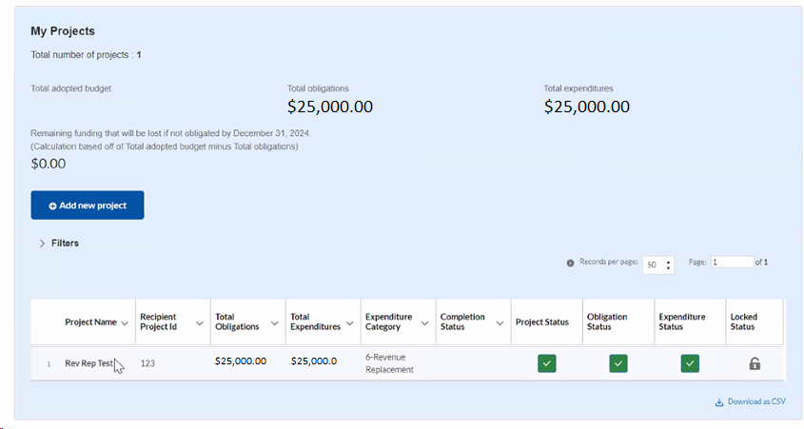
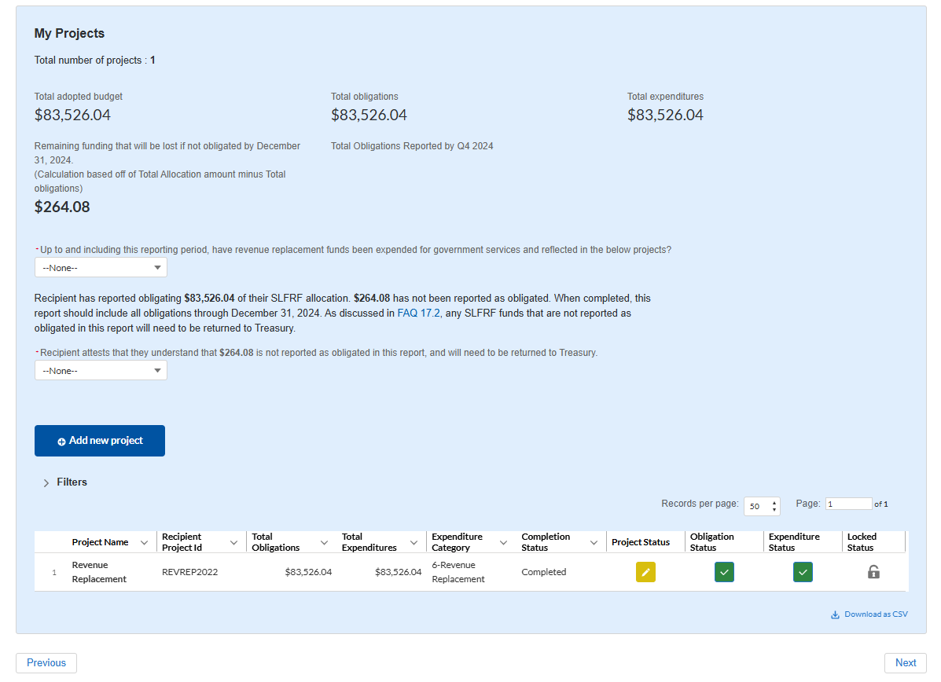

Scenario 1: All Funds Spent and Reported
Chose “Yes” to note a revenue replacement project has been created
To update a project added in a prior year, click the yellow pencil under Project Status to begin
27

Slide 29
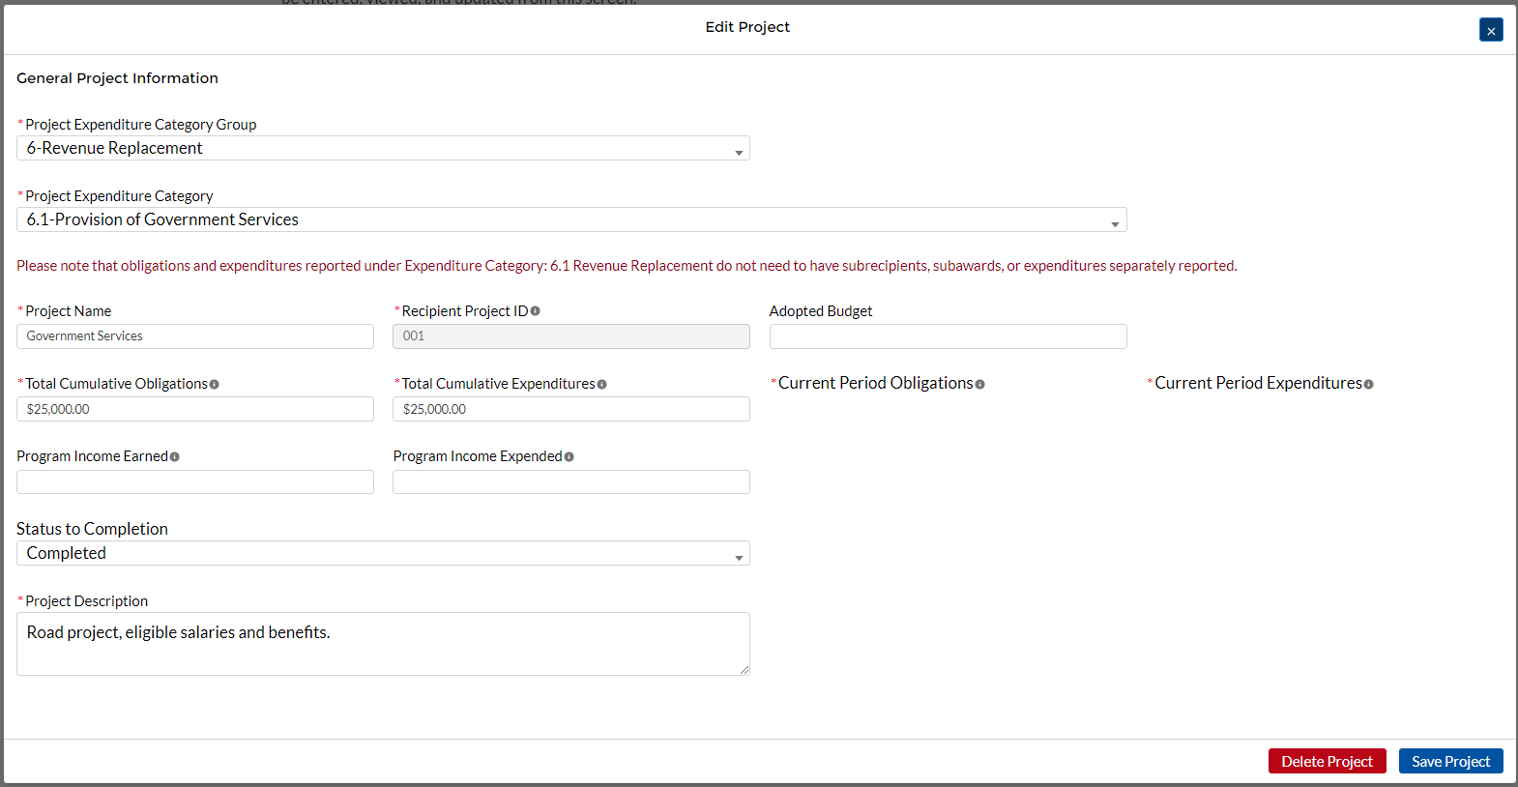
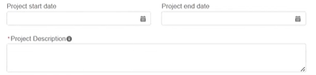

Scenario 1: Update Current Period Activity
If all funds were already reported and spent, as seen in the Cumulative boxes, update the Current Period boxes to $0
Make any additional updates to required fields as needed (description, project start and end date)
01/01/23
12/31/24
$15,000 was spent on maintenance of township roads, including tree trimming, patching potholes, to make a smoother and safer public road for our residents
28
Notes:
If all funds spent, just update current period to $0 and make sure status to completion says Completed

Slide 30
Tip: Review/Update Description
Treasury emphasized the need for adequate descriptions in Revenue Replacement projects
  Need about 3-5 sentences of specific information explaining how your township spent funds
  Vague entries like “revenue replacement” or “government services” are not enough!
This may be your last chance to update your project description!!
Tip: Type responses in Word and copy/paste into narrative box or click and drag the box to expand the field to type in several sentences
29

Slide 31




Description Examples from Treasury's Website
If your project descriptions look like these, please update!
If your description is not clear, vague, or appears incomplete, you are likely to receive a request from Treasury for documentation to prove how the funds were spent (and risk the possibility of Treasury asking for funds to be returned!)
30

Slide 32
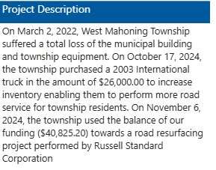
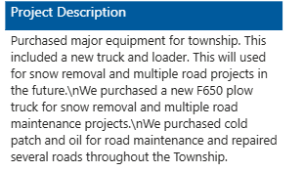
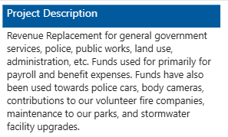
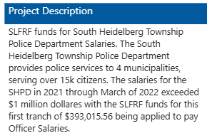
31

Slide 33
Tip: Address Required Fields Only
You must address fields marked with a red asterisk. Any fields that do not have this mark are not required and can be skipped to simplify reporting
Common issues on non-required fields include:
  An amount entered in "Adopted Budget" - this refers to the budget for the project and is often confusing. Leave it blank!
  An amount entered in "Program Income Earned" or "Program Income Expended" - this is for projects which earned money or for interest or principle made on loans from funds. Most likely, townships did not use the funds for these purposes, so leave them blank!
If you have something entered in these fields, delete the entry and confirm your project to update
32

Slide 34

Scenario 1: Project Overview Updated
Note the remaining balance of funding not obligated is $0.00 - so this example shows that all funds have been obligated and also expended.
33
Notes:
Another new feature: now have the ability to lock a project. If locked, it’s a helpful tool to keep track of which projects are completed should you have multiple projects

Slide 35
Scenario 2: Updating a Prior Project
Updating the expenditure amount, the expenditure category, the project description, or any other information from a previously entered project
$5,000
In this example, we need to update the expenditure amount to reflect that all the funds were spent AND update the project category to 6 – Revenue Replacement
$5,000
34

Slide 36
Scenario 2: Updating project category
Select the Project Expenditure Category Group dropdown to update to 6 - Revenue Replacement
Another dropdown will appear. Choose 6.1 - Provision of Government Services
Please note, some red text will appear, indicating that your report has been simplified
35

Slide 37
Scenario 2: Updating obligations/expenses
First, update Current Period Obligations and Current Period Expenditures boxes – these amounts should match.
  Funds obligated and spent between April 2025 - March 2026
Update Cumulative Expenditures box
  Funds obligated and spent since the beginning of program. If you only have one project, the C.O. box should have your full award amount already entered.
36

Slide 38
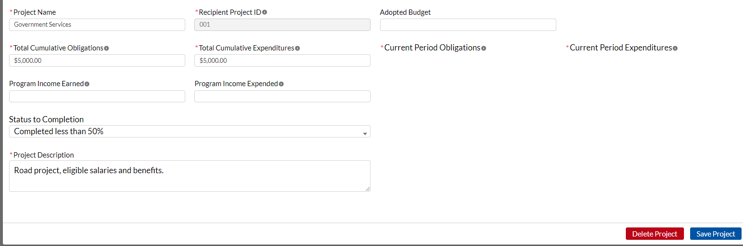
Scenario 2: Updating project details
Make any other updates as needed, including a strong description, start and end dates, etc. Then confirm project.
$25,000.00
$25,000.00
$20,000.00
$20,000.00
Start date
End date
Description of about 3-5 sentences describing things like how the funds were spent, population being served, the desired outcomes, etc.
37

Slide 39
Tip: Changing to Revenue Replacement
Townships should only use expenditure category
6 - Revenue Replacement for the easiest P&E report and Closeout report
After changing to 6/6.1, you will need to click on the Obligation Status and Expenditure Status boxes and delete anything previously entered
38

Slide 40
Scenario 2: Project Overview Updated
39

Slide 41
Tip: Troubleshooting Multiple Projects
If you have multiple projects, you must address/update each individually
The portal will add the total amounts of obligations and expenditures across all projects – you cannot exceed your full award amount!
If you see a negative number, edit projects until your expenditures are > your award amount
-$5,000.00
40

Slide 42
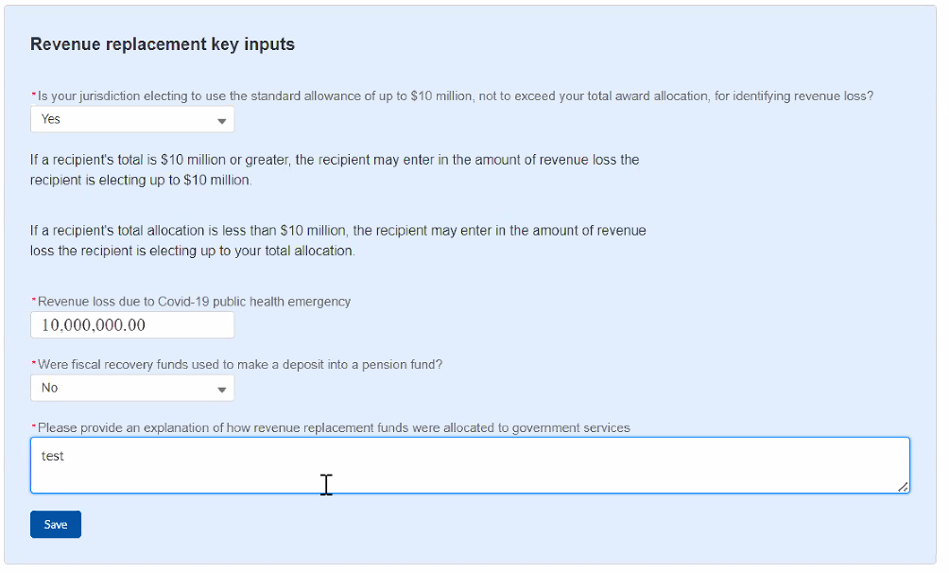
Recipient Specific Page
This page displays answers entered from prior reports. All townships should have:
- "Yes" in the first dropdown (indicating using the standard allowance option)
- Full award in the "Revenue Loss due to COVID-19" field
- A description outlining your Revenue Replacement project(s)
[Enter full award amount]
[Description of how ARP Funds were spent on Revenue Replacement projects. Can copy and paste the description from your project page]
41

Slide 43
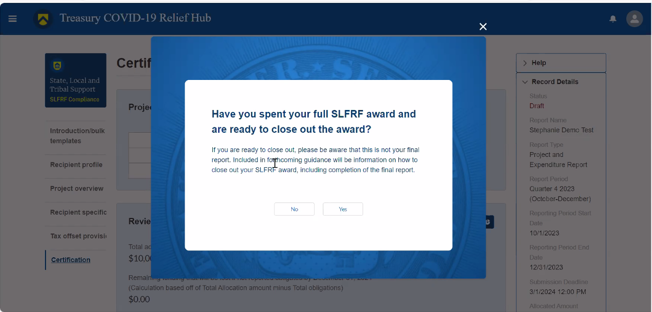
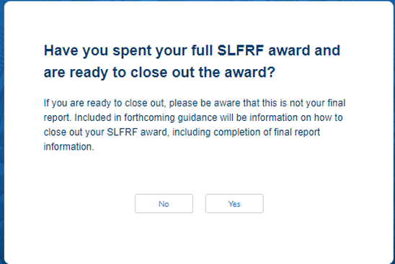
Certify and Submit the Report
If you report all of your funds as expended, this prompt will appear. Please note, it is NOT the closeout report!
42
Notes:
Final page!

Slide 44
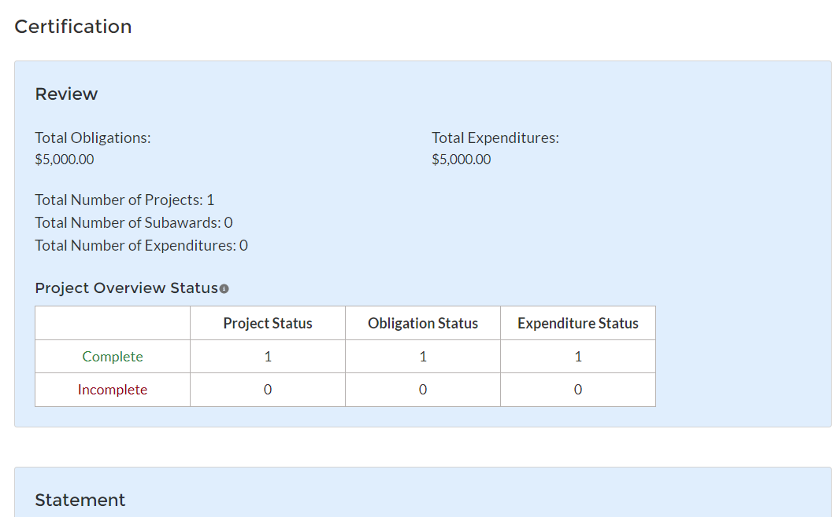
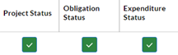
Certification Page
Review obligations, expenditures, and projects for accuracy
“Complete” row is showing the number of green checkmark projects from Project Overview screen:
“Incomplete” row will always appear. You should have all “0”s in this row
43

Slide 45
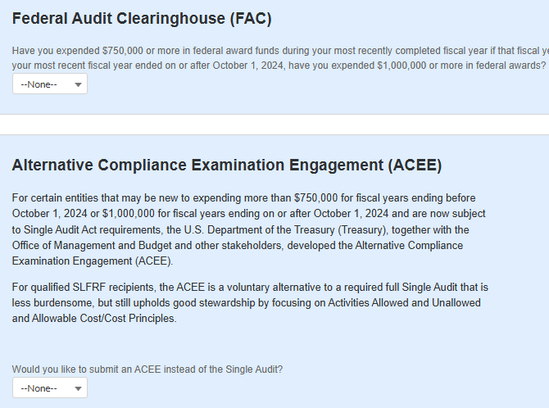
Federal Audit Dropdowns
Reminder: Treasury developed alternative audit for SLFRF
If your township did not spend $750,000 or more in federal funds last year, both audit dropdowns should be “No”
44

Slide 46
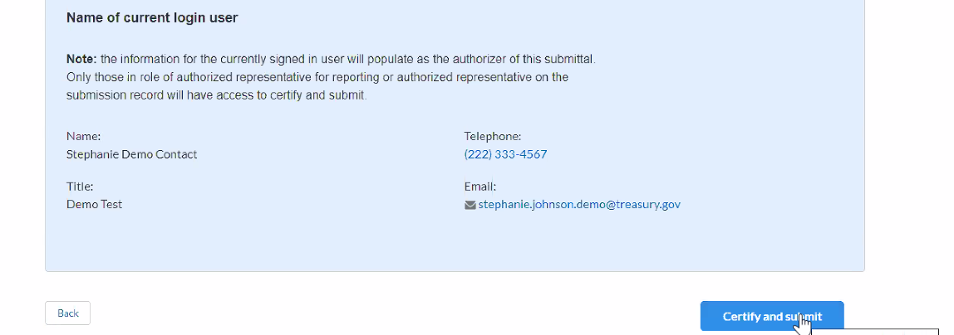
Certify and Submit the Report
After reviewing for accuracy, click Certify and Submit. A pop-up will appear to confirm that you want to submit
The program will then check for technical errors (ex: missing required information) and will communicate where any issues are located at the top of the screen
If you see another name listed:
You are in the portal with someone elses's credentials. Update contacts and roles before submitting!
STOP
45

Slide 47
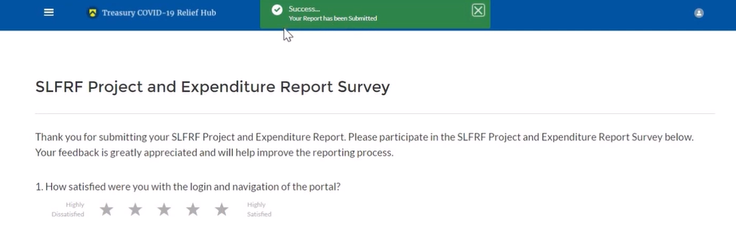
Successfully Submitted Report
After submitting, you should see a green "Success" notification at the top of your screen
The survey is not part of your report. You can complete it or click on the “hamburger” icon to go back to the home page
46

Slide 48
Final Thoughts on Projects
Verify your full award amount is obligated under Total Cumulative Obligations
Report projects under "6 Revenue Replacement" + "6.1 Provision of Govt. Services" for the easiest route
Include specifics in your project description (ex: populations served, project outcomes, what equipment purchases will be used towards, etc.)
47

Slide 49
Common Errors Troubleshooting
Recipient Profile page:
  Make sure you've addressed all required fields (fiscal year end date, confirm points of contact, sam.gov dropdown)
Project Overview page:
  Make sure you've addressed the "Up to and including..." Revenue Replacement dropdown
  Address each yellow box under project status
  If changing an existing project to category 6, you'll need to delete any information entered in the Obligation Status and Expenditure Status boxes (again, see yellow boxes)
48

Slide 50
Certification Troubleshooting
What happens if you hit Certify & Submit and get an error?
  Scroll up to the top – the report will tell you the page of the error and a general description of what needs to be addressed
What do we do if it doesn’t have our title in the certification box or shows a different name?
  Head to the designation form and make updates before submitting your report
49

Slide 51
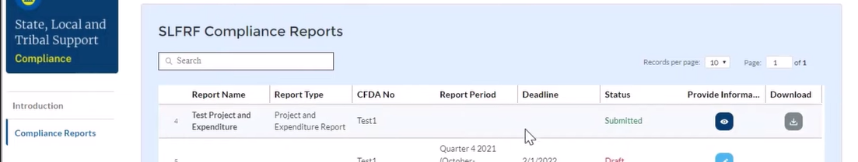
View Submitted Reports
Review or download submitted reports from the home page by clicking on Compliance Reports
  Grey Download button will download your submissions
  Blue Eyeball button will take you to the Recipient Profile to view your report
50

Slide 52
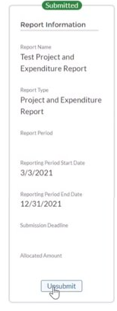
Editing A Submitted Report
You can adjust your report before the reporting deadline (April 30) by clicking the Unsubmit button
This returns your report to "Draft" status to allow you to make changes
You will need to recertify and resubmit before the reporting deadline!
  (April 30, 2026)
51

Slide 53
SAM.gov
Compliance Requirements
52

Slide 54
SAM.gov Registration
Townships are required to have an active SAM.gov registration to comply with SLFRF requirements, including closeout
  SAM.gov is also required for any future federal funding, including FEMA funds and any state grants paid for with federal funds
Annual renewal is required to maintain an active SAM.gov registration
Reminder: SAM.gov is 100% free!! Ignore any emails or mail that claims you must pay hundreds of dollars to renew!
53

Slide 55
SAM.gov Registration
To verify if your registration is active, log into your SAM.gov account to find the expiration date
When it's time to renew, find your active registration and click the "Update" button. Work your way through the questions – most of the answers will be prepopulated from your last renewal and just require review and updates!
PSATS developed a walkthrough guide to assist
  Head to psats.org, choose American Rescue Plan in the Quick Links, and scroll down to the SAM.gov Registration section
54

Slide 56
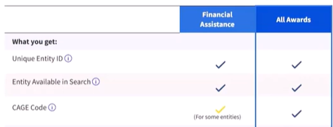
Tip: Make Your Renewal a Breeze
Choose "Financial Assistance" as the purpose of registration – the quickest route for entities who don't plan on contracting with the federal government
Have your authentication method and email handy – you will need to authenticate to log in and will receive email codes for IRS verification during the renewal
55

Slide 57
Tip: Don't Let Your Registration Expire
Renewals generally take between 10-20 minutes to complete when the information provided is still accurate and current
Reactivating an expired registration is possible but is a frustrating experience!
  Often takes weeks of communicating via email with the Federal Service Desk and finding documents proving your township's existence
  Time can be of the essence for an active SAM.gov registration, especially for FEMA funding!
56

Slide 58
Verify report completion
Prepare to Closeout
57

Slide 59
Verify NEU Agreements Report
Verify that the NEU Agreements and Supporting Documents report has been submitted.
This report was due several years ago and required townships to upload the following:
  Signed Award Terms and Conditions Agreement
  Signed Assurances of Compliance with Title VI of the Civil Rights Act of 1964
  Actual Budget Documents (township's actual 2020 budget that was adopted in 2019)
58

Slide 60
NEU Agreements Report
If this report is in a red “Draft” status, documents must be scanned and uploaded into the system
If you cannot find copies of the signed documents, reach out to DCED as soon as possible as they would have been uploaded into DCED’s Single Application Site when your township first requested the ARP funding in 2021
  888-223-6837
59

Slide 61
closeout report walkthrough
Reporting Requirements
60

Slide 62
Going to the Report
Click on Closeout Reports to get started
61

Slide 63
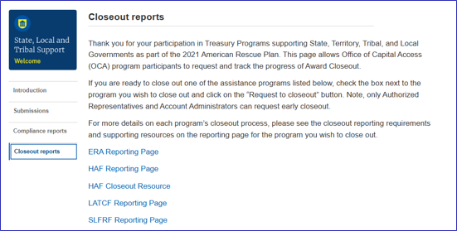
Going to the Report
On the Closeout Reports page, scroll down to find the Eligible for Closeout Report
The "Reporting Page" links will take you to Treasury's website for informational purposes
62

Slide 64
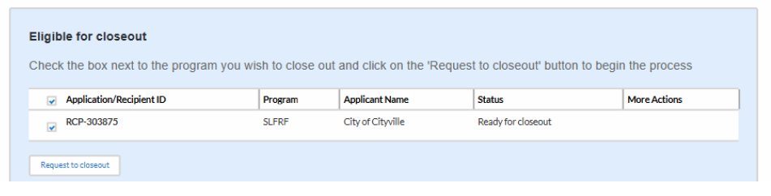
Begin Closeout Process
Once you find the SLFRF Eligible for Closeout Report, click the checkbox and then the button 'Request to Closeout'
This will launch a review process by Treasury to ensure eligibility and will send an email to the POC with next steps
If you've already received an email with instructions, you'll proceed to the next page
63

Slide 65
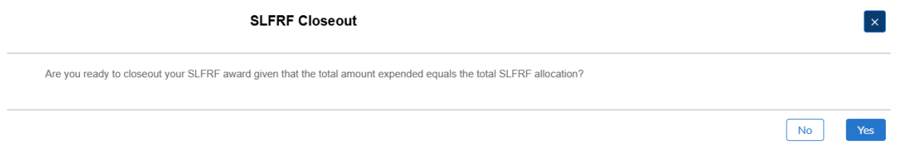
Confirm Ready to Closeout
You should be prompted with a question confirming readiness to closeout (select yes!!)
64

Slide 66
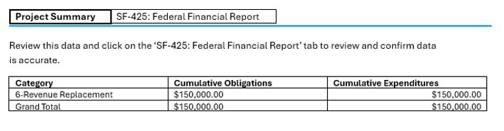
Review Reported Data
The next page will display a Project Summary tab outlining all of the projects entered in your most recent P&E Report along with the grand total of obligations and expenditures
Review this information for accuracy - you can click on the project to view your P&E Report in full, if needed
Click the SF-425 tab to continue
65

Slide 67
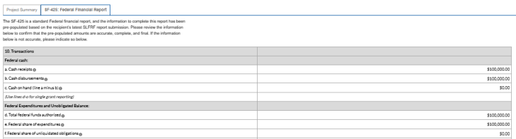
Review Reported Data
The SF-425 is a standard Federal financial report with prepopulated information based on the most recently submitted Project & Expenditure Report.
Review to confirm that the prepopulated amounts are accurate, complete, and final and then scroll down to the bottom of the page
66

Slide 68
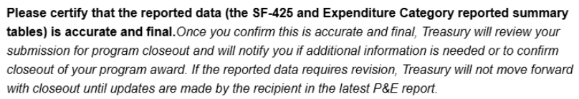

Certify Data is Accurate and Final
If the data appears correct, choose "Yes" to proceed
If the pre-populated data is inaccurate, select "No" to reopen the latest P&E Report to make corrections. The P&E report must be resubmitted to continue.
67

Slide 69
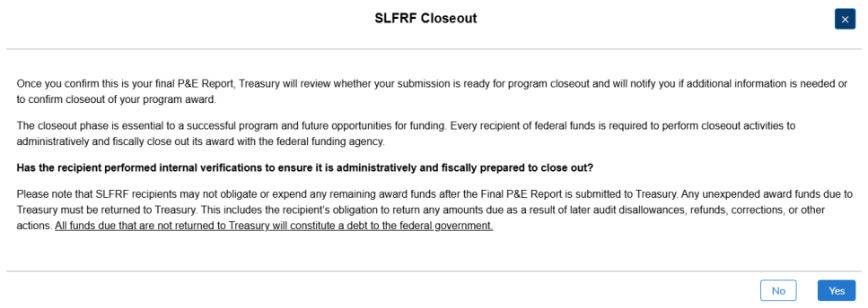
Confirm Final Report
Choose Yes to confirm submission of the last P&E Report as your final report and to confirm that you are prepared to finalize close out
68

Slide 70
Impact Statement Page
While not required, townships can share an impact story on the final page of the report to explain how the use of ARPA funds benefited your community, worked towards goals, and addressed needs
PSATS highly recommends using this feature!
  We have heard countless stories explaining how these funds helped townships stay open, bolstered public safety, tackled big projects, and otherwise made a difference. These stories are absolutely worth sharing!!
  This short snippet can be used to communicate to Treasury how federal grants impact local communities and how townships prioritize projects to best suit their community's needs
Once complete, click Confirm to finalize.
69

Slide 71
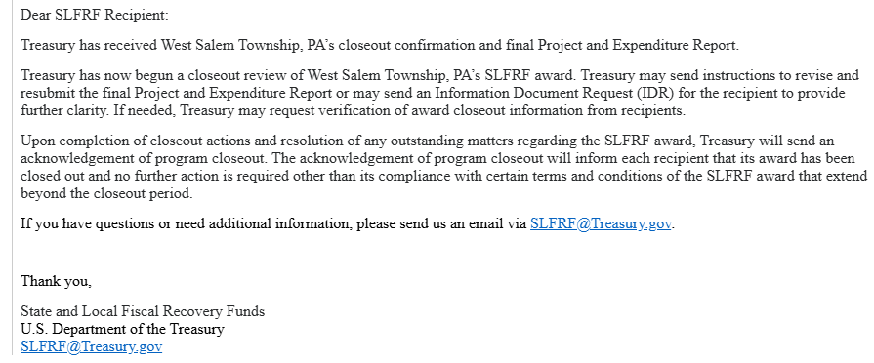
Closeout Submitted
Once complete, you should receive a confirmation email from SLFRF@treasury.gov shortly thereafter with additional information and possible next steps
70

Slide 72
Information Document requests
Compliance Requirements
71

Slide 73
Information Requests
Treasury will perform compliance checks and may send Information Document Requests
  If Treasury requires additional information, an IDR notice will be sent via email and the specifics will be found within your portal account
Recipients must respond to the IDR and certify and submit their response within the Treasury Portal in a timely manner
72

Slide 74
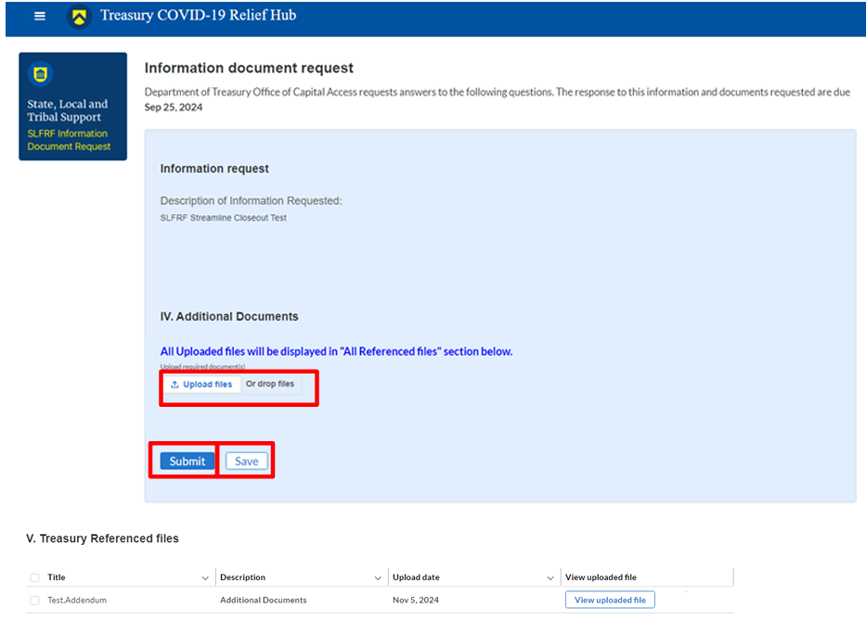
Responding to an IDR
1. The "Description of Information Requested" will explain documentation Treasury requires. Read this description carefully!
2. Upload documents responsive to the IDR description
3. Click Submit and then Save to upload
Click "View uploaded file" to confirm the correct file was submitted
73

Slide 75
Final Reminders
Make sure you update the Points of Contact information in the portal
If you receive an error on a page that looks correct (ex: FY End Date), try again or come back later
Keep an eye on your email for updates
If you run into issues on Treasury's Portal:
  Send an email to Treasury with screenshots, document the issue
  Hold onto your case number (should receive shortly after emailing)
  Don't panic and be patient!
74

Slide 76
Questions?
Holly Fishel
Hfishel@psats.org
717-763-0930 ext. 138
Katie Lizza
Klizza@psats.org
717-763-0930 ext. 126
Treasury's Contact Information
SLFRF@Treasury.gov
COVIDReliefITSupport@Treasury.gov
75

